Slide 1
Chapter 3

Slide 2
Introduction to Regression
Regression is a statistical procedure that determines the equation for the straight line that best fits a specific set of data.
Regression is how one variable affects another, or changes in a variable that trigger changes in another, essentially cause and effect. It implies that the outcome is dependent on one or more variables.
The main objective of regression analysis is to estimate the values of a random variable (z) based on the values of your known (or fixed) variables (x and y).
2
Notes:
2

Slide 3
Introduction to Regression
Any straight line can be represented by an equation of the form Y = bX + a, where b and a are constants.
The value of b is called the slope constant and determines the direction and degree to which the line is tilted.
The value of a is called the Y-intercept and determines the point where the line crosses the Y-axis.
3
Notes:
3

Slide 4
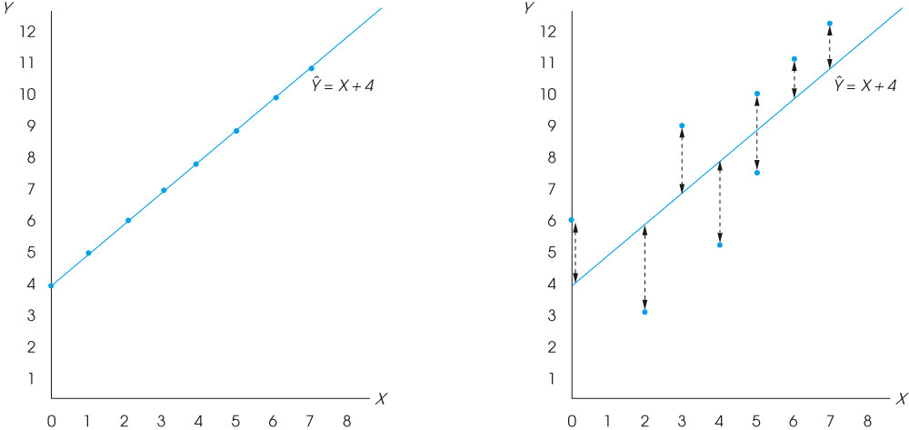
Introduction to Regression
4
Notes:
4

Slide 5
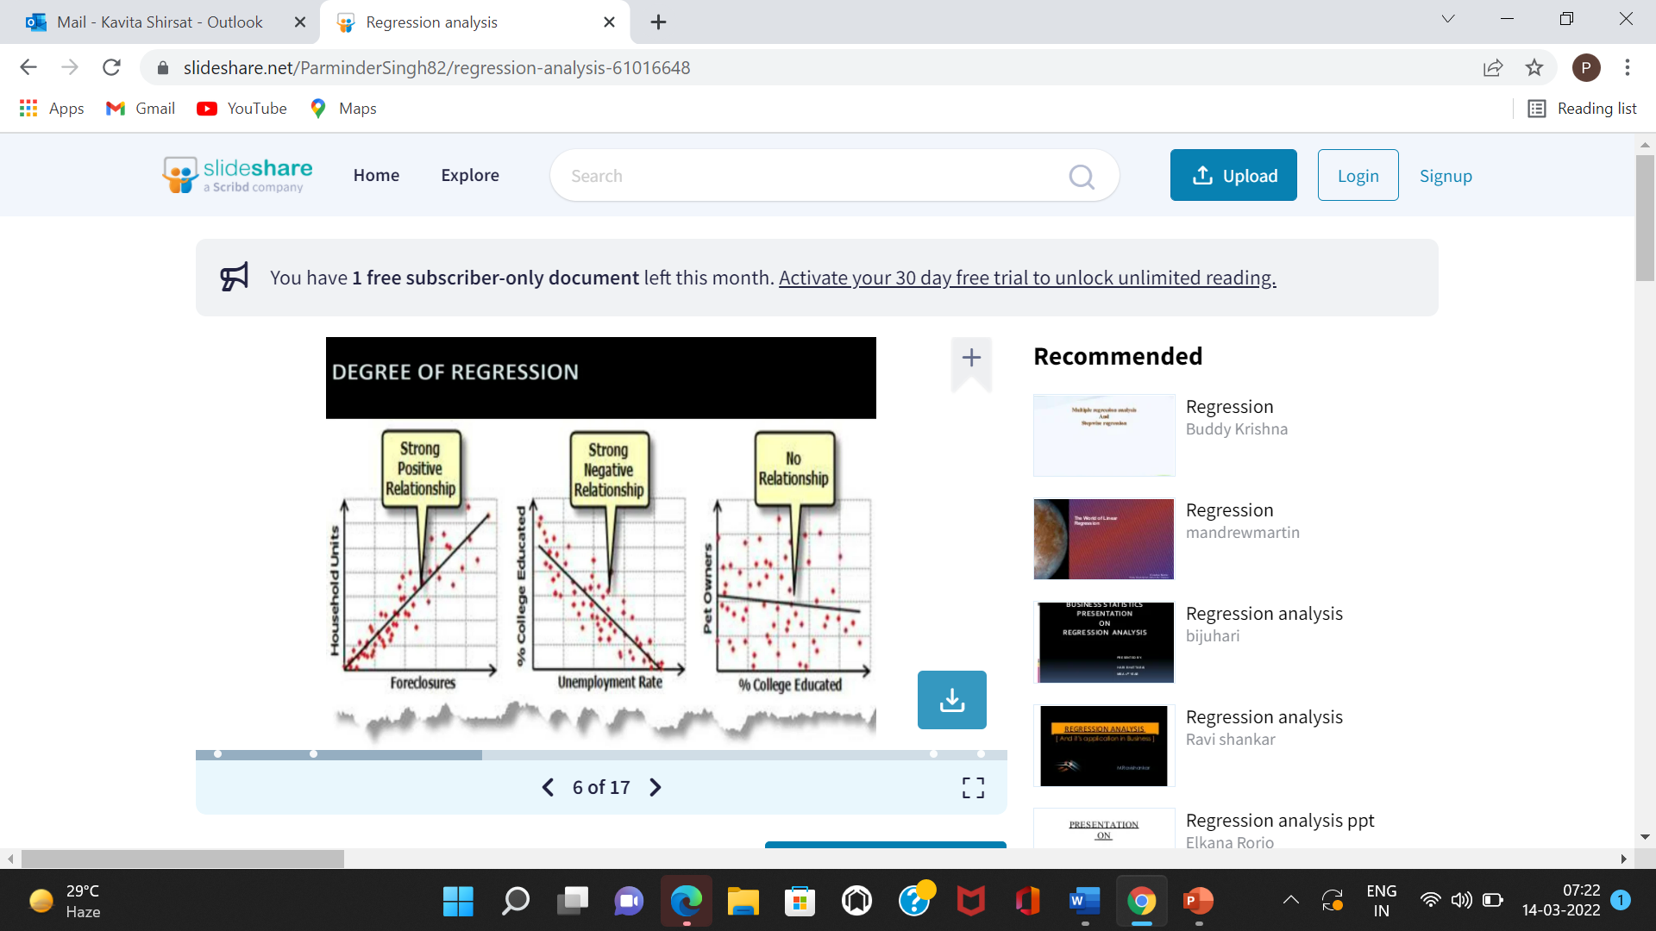
Degree of Regression

Slide 6
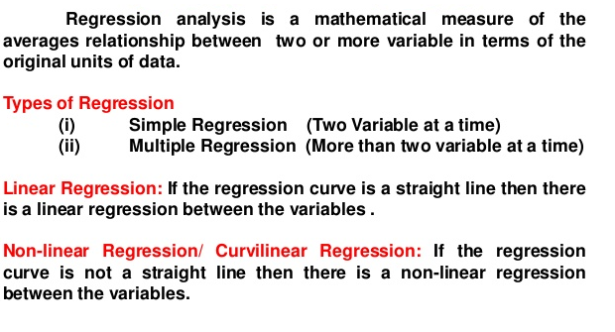
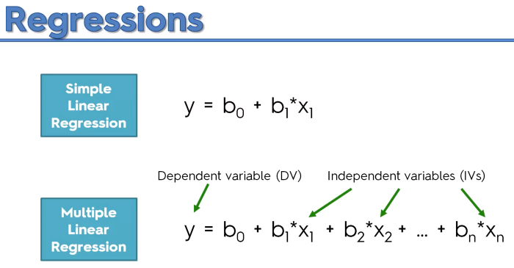
Introduction to Regression
6
Notes:
6

Slide 7
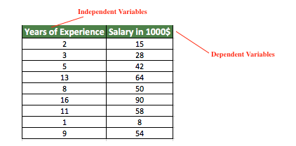
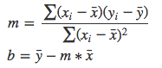
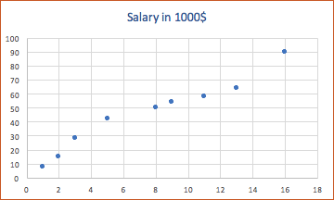
Introduction to Regression
Y = mx + b
7
7
Notes:
7

Slide 8
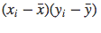

Introduction to Regression
Regression Analysis
Years of Experience xi | Salary (in 1000$)yi
2 | 15 | -5.56 | -30.44 | 169.25 | 30.91
3 | 28 | -4.56 | -17.44 | 79.53 | 20.79
5 | 42 | -2.56 | -3.44 | 8.81 | 6.55
13 | 64 | 5.44 | 18.56 | 100.97 | 29.59
8 | 50 | 0.44 | 4.56 | 2.01 | 0.19
16 | 90 | 8.44 | 44.56 | 376.09 | 71.23
11 | 58 | 3.44 | 12.56 | 43.21 | 11.83
1 | 8 | -6.56 | -37.44 | 245.61 | 43.03
9 | 54 | 1.44 | 8.56 | 12.33 | 2.07
7.56 | 45.44 |  |  | 1037.81 | 216.19
8
8
Notes:
8

Slide 9
Introduction to Regression
m = 1037.8 / 216.19
m = 4.80
b = 45.44 - 4.80 * 7.56 = 9.15
Hence, y = mx + b → 4.80x + 9.15
y = 4.80x + 9.15
9
Notes:
9

Slide 10
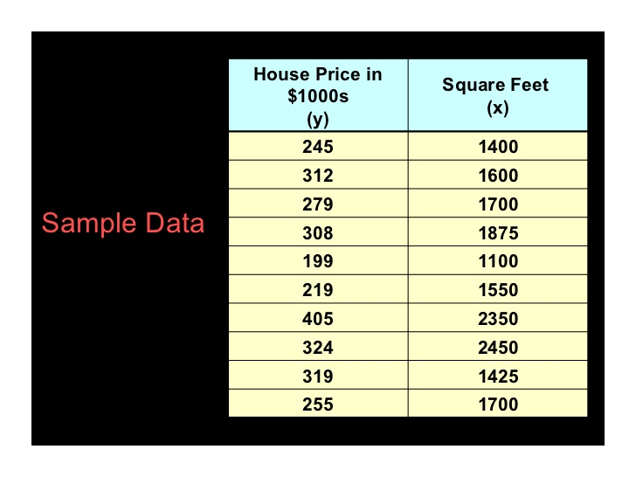
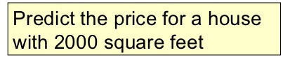
Regression Analysis
10
10
Notes:
10

Slide 11
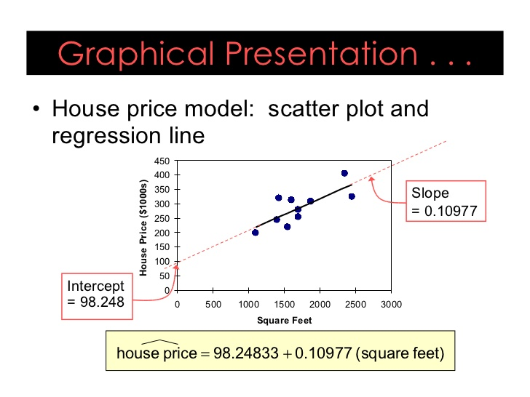
Regression Analysis
11
Notes:
11

Slide 12
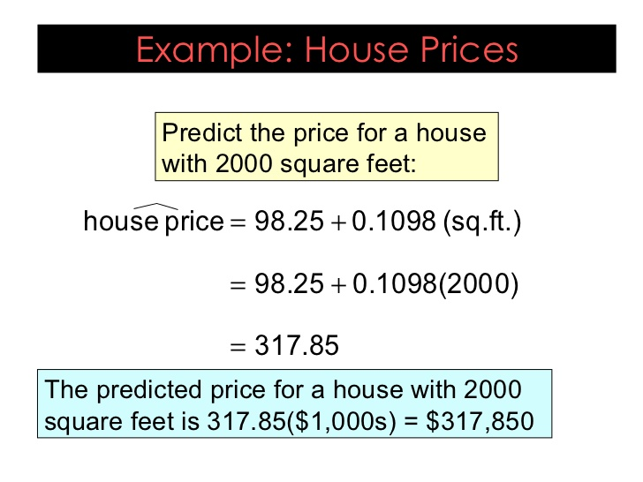
Regression Analysis
12
Notes:
12

Slide 13
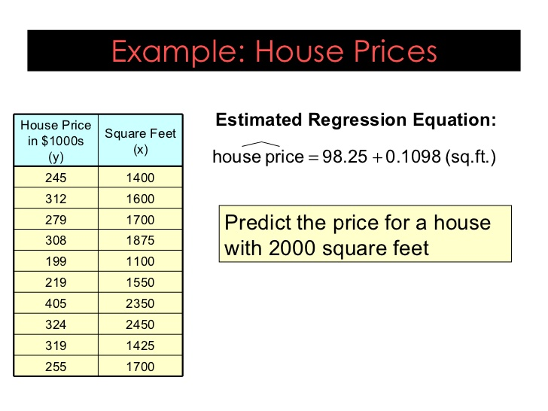
Regression Analysis
13
Notes:
13

Slide 14
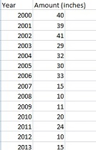
Regression Analysis
Predict how much snow will fall 2017
14
Notes:
14

Slide 15
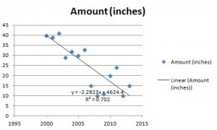
Regression Analysis
y = -2.2923x + 4624.4
y = 2.2923(2017) + 4624.4 = 0.8 inches.
15
15
Notes:
15

Slide 16
Multiple linear regression
Multiple linear regression is a method we can use to quantify the relationship between two or more predictor variables and a response variable.
Y = β₀ + β₁X₁ + β₂X₂ + … + β_{p}X_{p} + ε
where:
Y: The response variable
X_{j}: The j^{th} predictor variable
β_{j}: The average effect on Y of a one unit increase in X_{j}, holding all other predictors fixed
ε: The error term

Slide 17
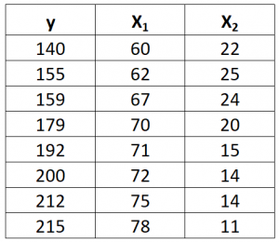
Multiple Linear Regression
ŷ = b₀ + b₁*x₁ + b₂*x₂

Slide 18
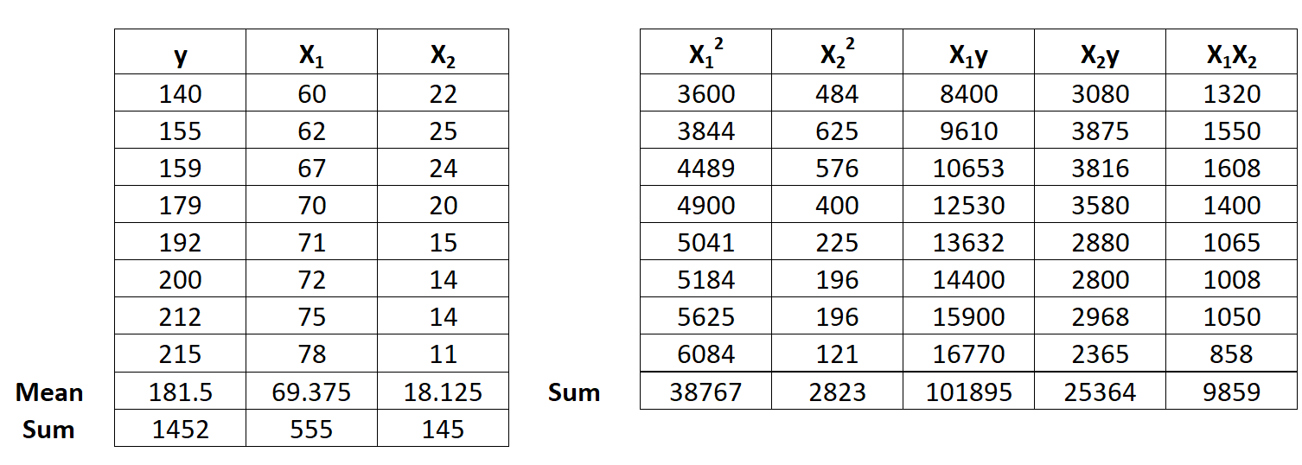
Multiple Linear Regression
Step 1: Calcúlate X₁², X₂², X₁y, X₂y and X₁X₂.

Slide 19
Multiple Linear Regression
Calculate Regression Sums.
Next, make the following regression sum calculations
Σx₁² = ΣX₁² – (ΣX₁)² / n = 38,767 – (555)² / 8 = 263.875
Σx₂² = ΣX₂² – (ΣX₂)² / n = 2,823 – (145)² / 8 = 194.875
Σx₁y = ΣX₁y – (ΣX₁Σy) / n = 101,895 – (555*1,452) / 8 = 1,162.5
Σx₂y = ΣX₂y – (ΣX₂Σy) / n = 25,364 – (145*1,452) / 8 = -953.5
Σx₁x₂ = ΣX₁X₂ – (ΣX₁ΣX₂) / n = 9,859 – (555*145) / 8 = -200.375

Slide 20
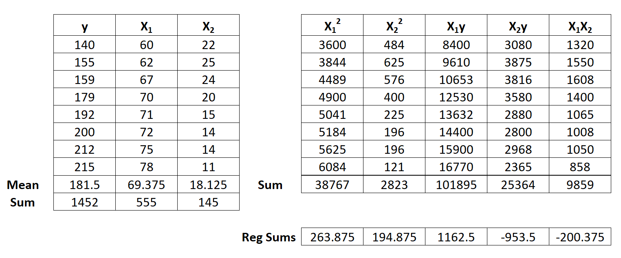
Multiple Linear Regression

Slide 21
Multiple Linear Regression
Step 3: Calculate b₀, b₁, and b₂
The formula to calculate b₁ is: [(Σx₂²)(Σx₁y) – (Σx₁x₂)(Σx₂y)] / [(Σx₁²) (Σx₂²) – (Σx₁x₂)²]
Thus, b₁ = [(194.875)(1162.5) – (-200.375)(-953.5)] / [(263.875) (194.875) – (-200.375)²] = 3.148
The formula to calculate b₂ is: [(Σx₁²)(Σx₂y) – (Σx₁x₂)(Σx₁y)] / [(Σx₁²) (Σx₂²) – (Σx₁x₂)²]
Thus, b₂ = [(263.875)(-953.5) – (-200.375)(1152.5)] / [(263.875) (194.875) – (-200.375)²] = -1.656
The formula to calculate b₀ is: y – b₁X₁ – b₂X₂
Thus, b₀ = 181.5 – 3.148(69.375) – (-1.656)(18.125) = -6.867
Step 5: Place b₀, b₁, and b₂ in the estimated linear regression equation.
The estimated linear regression equation is: ŷ = b₀ + b₁*x₁ + b₂*x₂
ŷ = -6.867 + 3.148x₁ – 1.656x₂

Slide 22
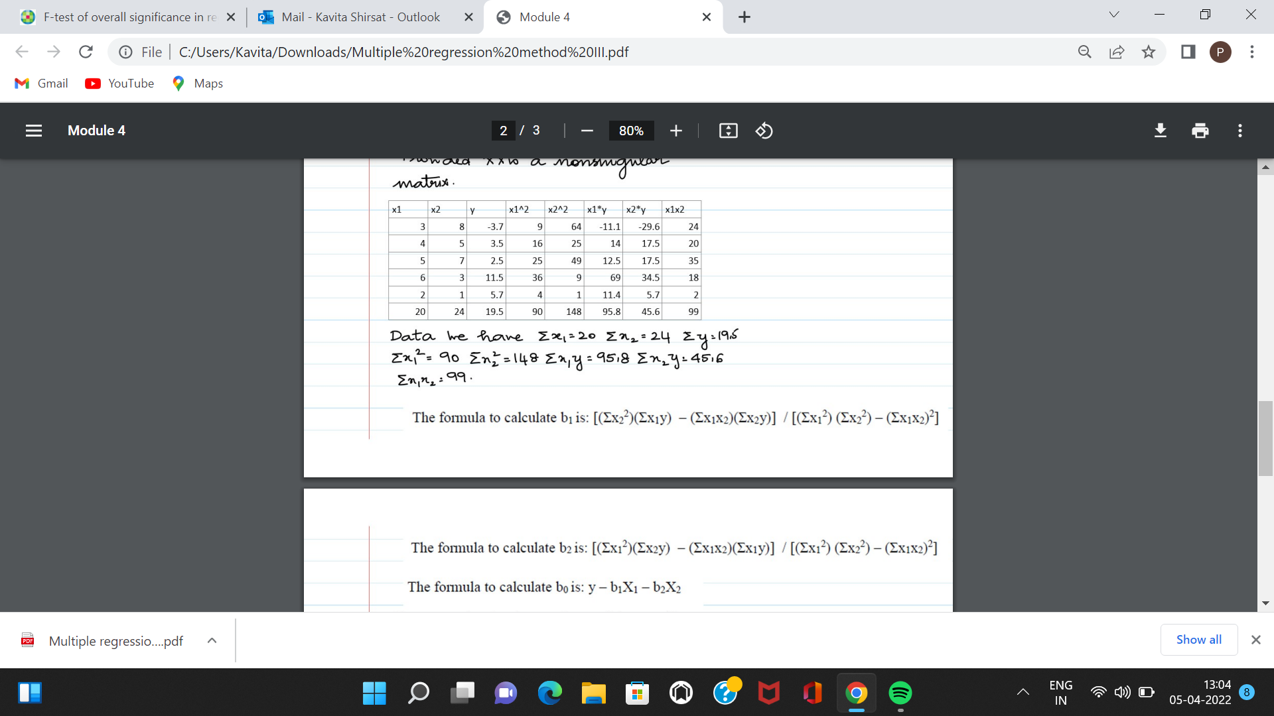
Multiple Linear Regression
The estimated linear regression equation.
The estimated linear regression equation is: ŷ = b₀ + b₁*x₁ + b₂*x₂
Calculate Regression Sums.
Σx₁² = ΣX₁² – (ΣX₁)² / n
Σx₂² = ΣX₂² – (ΣX₂)² / n
Σx₁y = ΣX₁y – (ΣX₁Σy) / n
Σx₂y = ΣX₂y – (ΣX₂Σy) / n
Σx₁x₂ = ΣX₁X₂ – (ΣX₁ΣX₂) / n
The formula to calculate b₁ is: [(Σx₂²)(Σx₁y) – (Σx₁x₂)(Σx₂y)] / [(Σx₁²) (Σx₂²) – (Σx₁x₂)²]
The formula to calculate b2 is: [(Σx12)(Σx2y) – (Σx1x2)(Σx1y)] / [(Σx12) (Σx22) – (Σx1x2)2]
The formula to calculate b₀ is: y – b₁X₁ – b₂X₂

Slide 23
Multiple Linear Regression
X1 | X2 | Y | X1^2 | X2^2 | X1Y | X2Y | X1X2
3 | 8 | -3.7
4 | 5 | 3.5
5 | 7 | 2.5
6 | 3 | 11.5
2 | 1 | 5.7
20 | 24 | 19.5

Slide 24
Calculate Regression Sums.
Σx₁² = ΣX₁² – (ΣX₁)² / n =(90-(20)^2/5)
Σx₂² = ΣX₂² – (ΣX₂)² / n
Σx₁y = ΣX₁y – (ΣX₁Σy) / n
Σx₂y = ΣX₂y – (ΣX₂Σy) / n
Σx₁x₂ = ΣX₁X₂ – (ΣX₁ΣX₂) / n

Slide 25
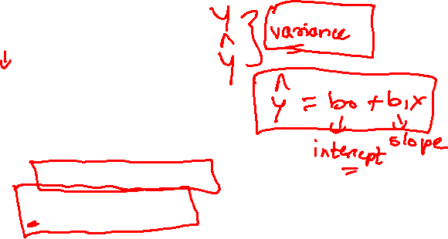
Multiple Linear Regression
Calculate b₀, b₁, and b₂
The formula to calculate b₁ is: [(Σx₂²)(Σx₁y) – (Σx₁x₂)(Σx₂y)] / [(Σx₁²) (Σx₂²) – (Σx₁x₂)²]
Thus, b₁ =
The formula to calculate b₂ is: [(Σx₁²)(Σx₂y) – (Σx₁x₂)(Σx₁y)] / [(Σx₁²) (Σx₂²) – (Σx₁x₂)²]
Thus, b₂ =
The formula to calculate b₀ is: y – b₁X₁ – b₂X₂
Thus, b₀ =
Place b₀, b₁, and b₂ in the estimated linear regression equation.
The estimated linear regression equation is: ŷ = b₀ + b₁*x₁ + b₂*x₂
ŷ = + x₁ – x₂

Slide 26
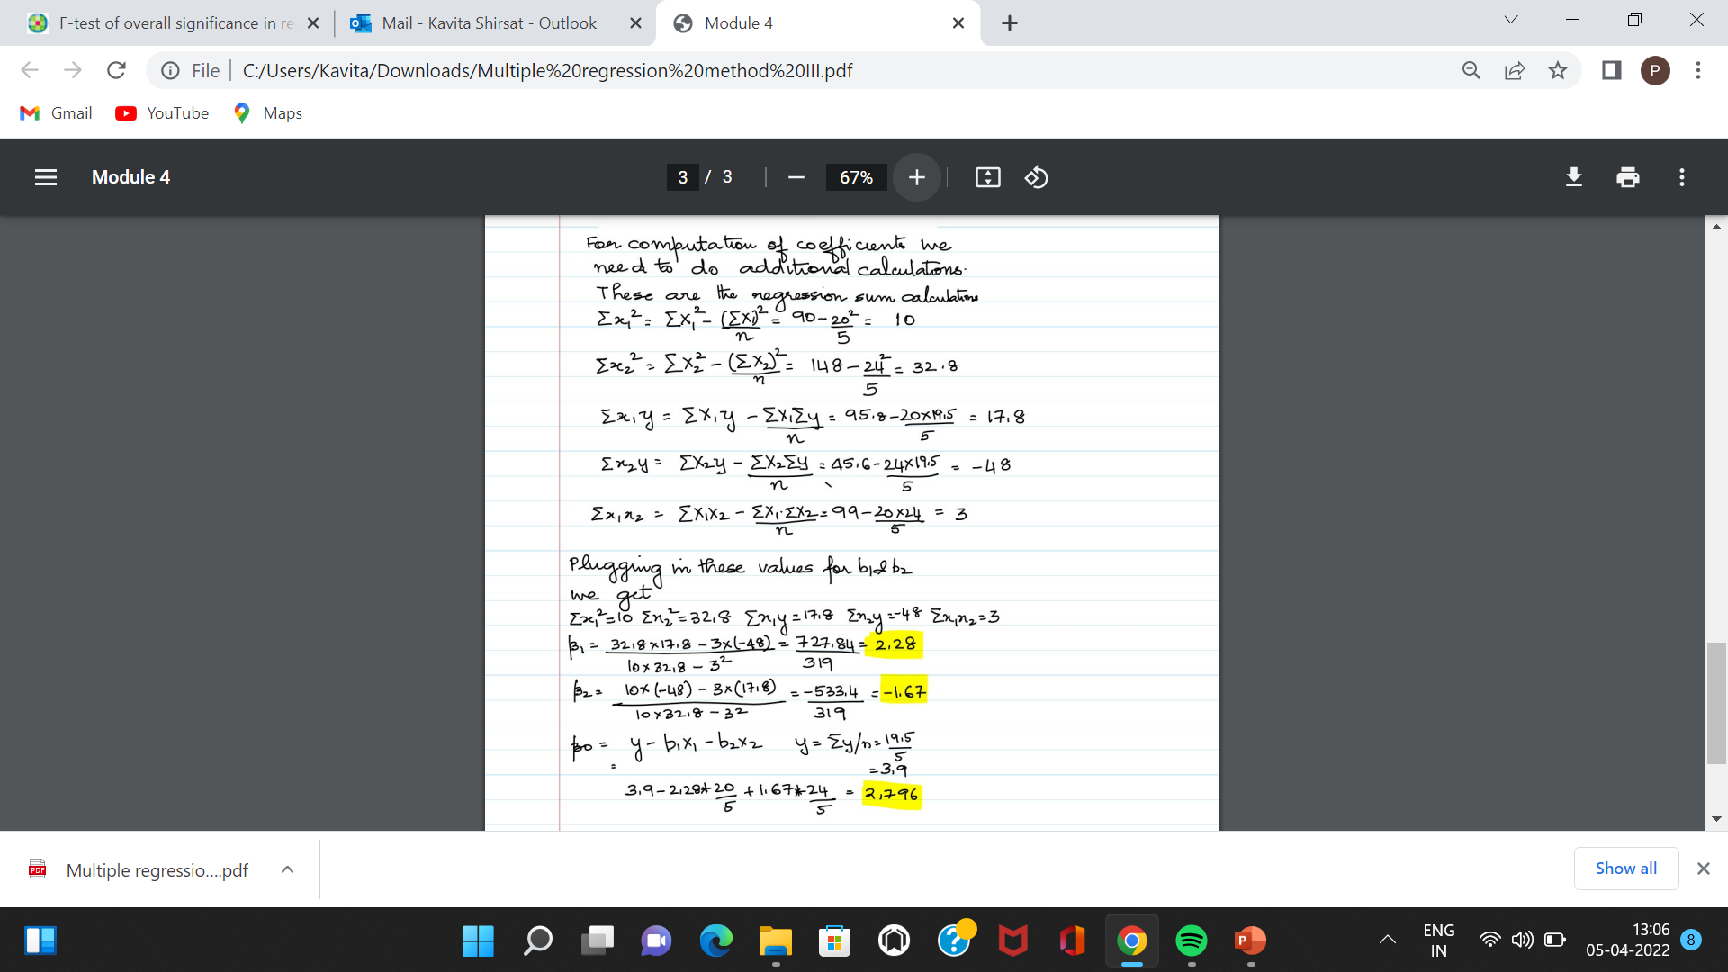
Multiple Linear Regression

Slide 27
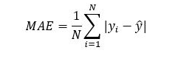
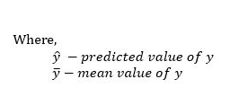
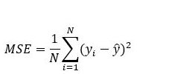


Regression model evaluation metrics
The MSE, MAE, RMSE, and R-Squared metrics are mainly used to evaluate the prediction error rates and model performance in regression analysis.
MAE (Mean absolute error) represents the difference between the original and predicted values extracted by averaged the absolute difference over the data set.
MSE (Mean Squared Error) represents the difference between the original and predicted values extracted by squared the average difference over the data set.

Slide 28
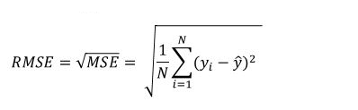
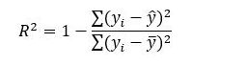
Regression model evaluation metrics
RMSE (Root Mean Squared Error) is the error rate by the square root of MSE.
R-squared (Coefficient of determination) represents the coefficient of how well the values fit compared to the original values. The value from 0 to 1 interpreted as percentages. The higher the value is, the better the model is.

Slide 29
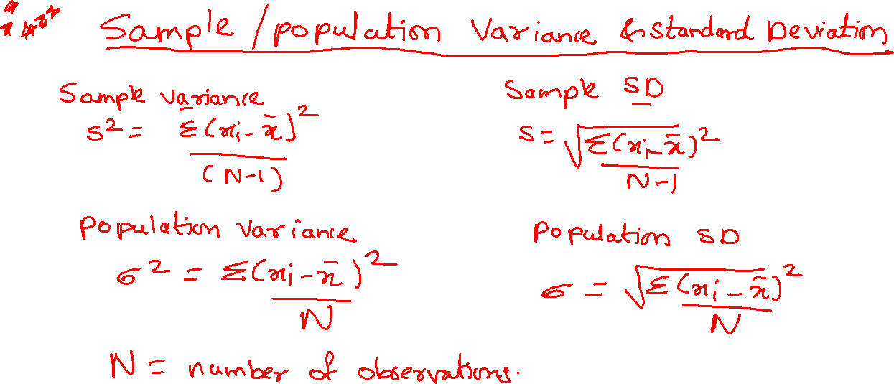

Slide 30
Testing Significance overall significance of Overall fit of the model,
The F-Test of overall significance in regression is a test of whether or not your linear regression model provides a better fit to a dataset than a model with no predictor variables.
An F-test is a type of statistical test can evaluate multiple model terms simultaneously, which allows them to compare the fits of different linear models.
The F-test for overall significance has the following two hypotheses:
The null hypothesis states that the model with no independent variables fits the data as well as your model.
The alternative hypothesis says that your model fits the data better than the intercept-only model.
Suppose we have a linear regression model like the one below
Y_{i} = α +Y_{i} = α + β₁X₁ + β₂X₂ + β₃X₃ + … + β_{n}X_{n} +ε_{i}
Where Y is the dependent variable and X₁,X₂,X₃ are the predictors.Now, the hypothesis to test overall significance of the model will be like
H_{N} (Null Hypothesis): β₁ = β₂ = β₃ = … = β_{n} =0
H_{A} (Alternative Hypothesis): Not all βs are simultaneously zero

Slide 31

When conducting a significance test, the goal is to provide evidence to reject the null hypothesis.
If the evidence is strong enough to reject the null hypothesis, then the alternative hypothesis can automatically be accepted. However, if the evidence is not strong enough, researchers fail to reject the null hypothesis.

Slide 32
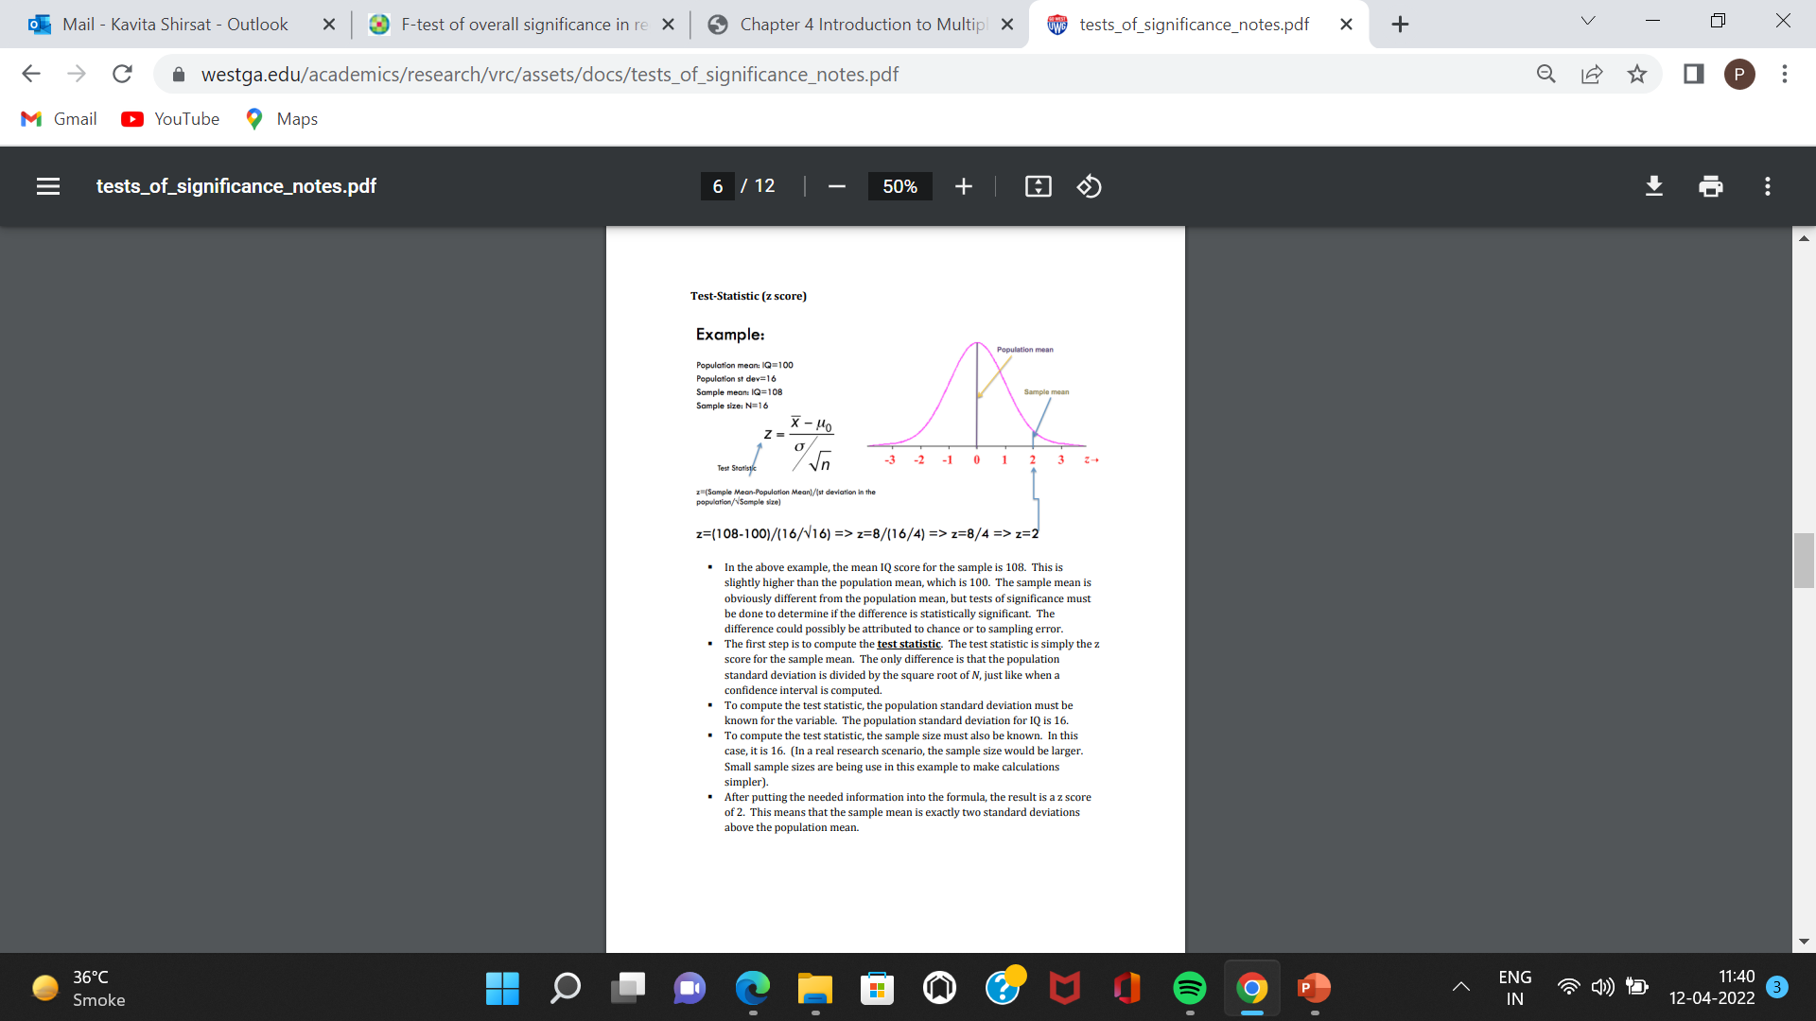
Test-Statistic (z score)
In the above example, the mean IQ score for the sample is 108. This is slightly higher than the population mean, which is 100. The sample mean is obviously different from the population mean, but tests of significance must be done to determine if the difference is statistically significant. The difference could possibly be attributed to chance or to sampling error.
The first step is to compute the test statistic.
The test statistic is simply the z score for the sample mean.
To compute the test statistic, the population standard deviation for IQ is 16.
sample size =16. (In a real research scenario, the sample size would be larger. Small sample sizes are being use in this example to make calculations simpler).
After putting the needed information into the formula, the result is a z score of 2. This means that the sample mean is exactly two standard deviations above the population mean

Slide 33
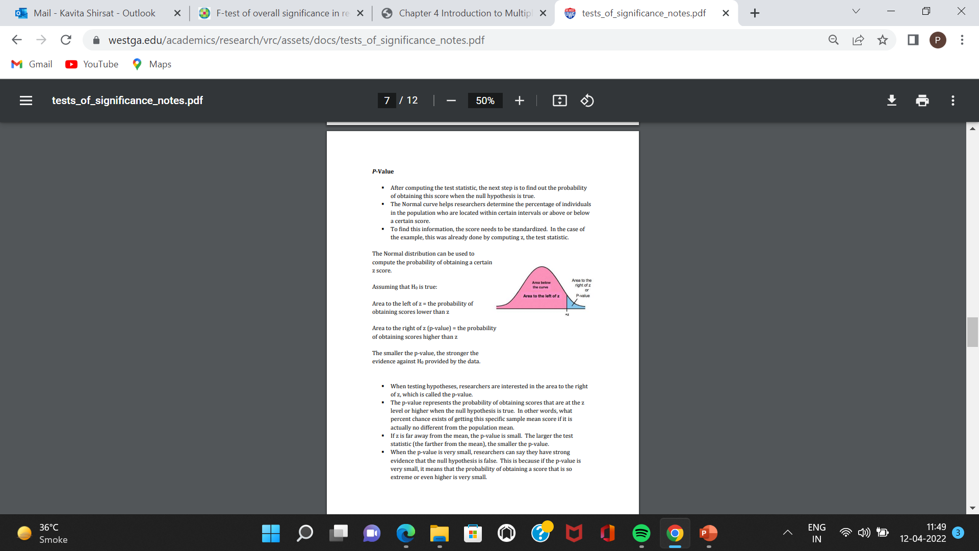
P-Value
After computing the test statistic, the next step is to find out the probability of obtaining this score when the null hypothesis is true.
The Normal distribution can be used to compute the probability of obtaining a certain z score.
Assuming that H0 is true:
Area to the left of z = the probability of obtaining scores lower than z
Area to the right of z (p-value) = the probability of obtaining scores higher than z
The smaller the p-value, the stronger the evidence against H0 provided by the data.
When testing hypotheses, researchers are interested in the area to the right of z, which is called the p-value.
The p-value represents the probability of obtaining scores that are at the z level or higher when the null hypothesis is true. In other words, what percent chance exists of getting this specific sample mean score if it is actually no different from the population mean.
If z is far away from the mean, the p-value is small. The larger the test statistic (the farther from the mean), the smaller the p-value.
When the p-value is very small, researchers can say they have strong evidence that the null hypothesis is false. This is because if the p-value is very small, it means that the probability of obtaining a score that is so extreme or even higher is very small.

Slide 34
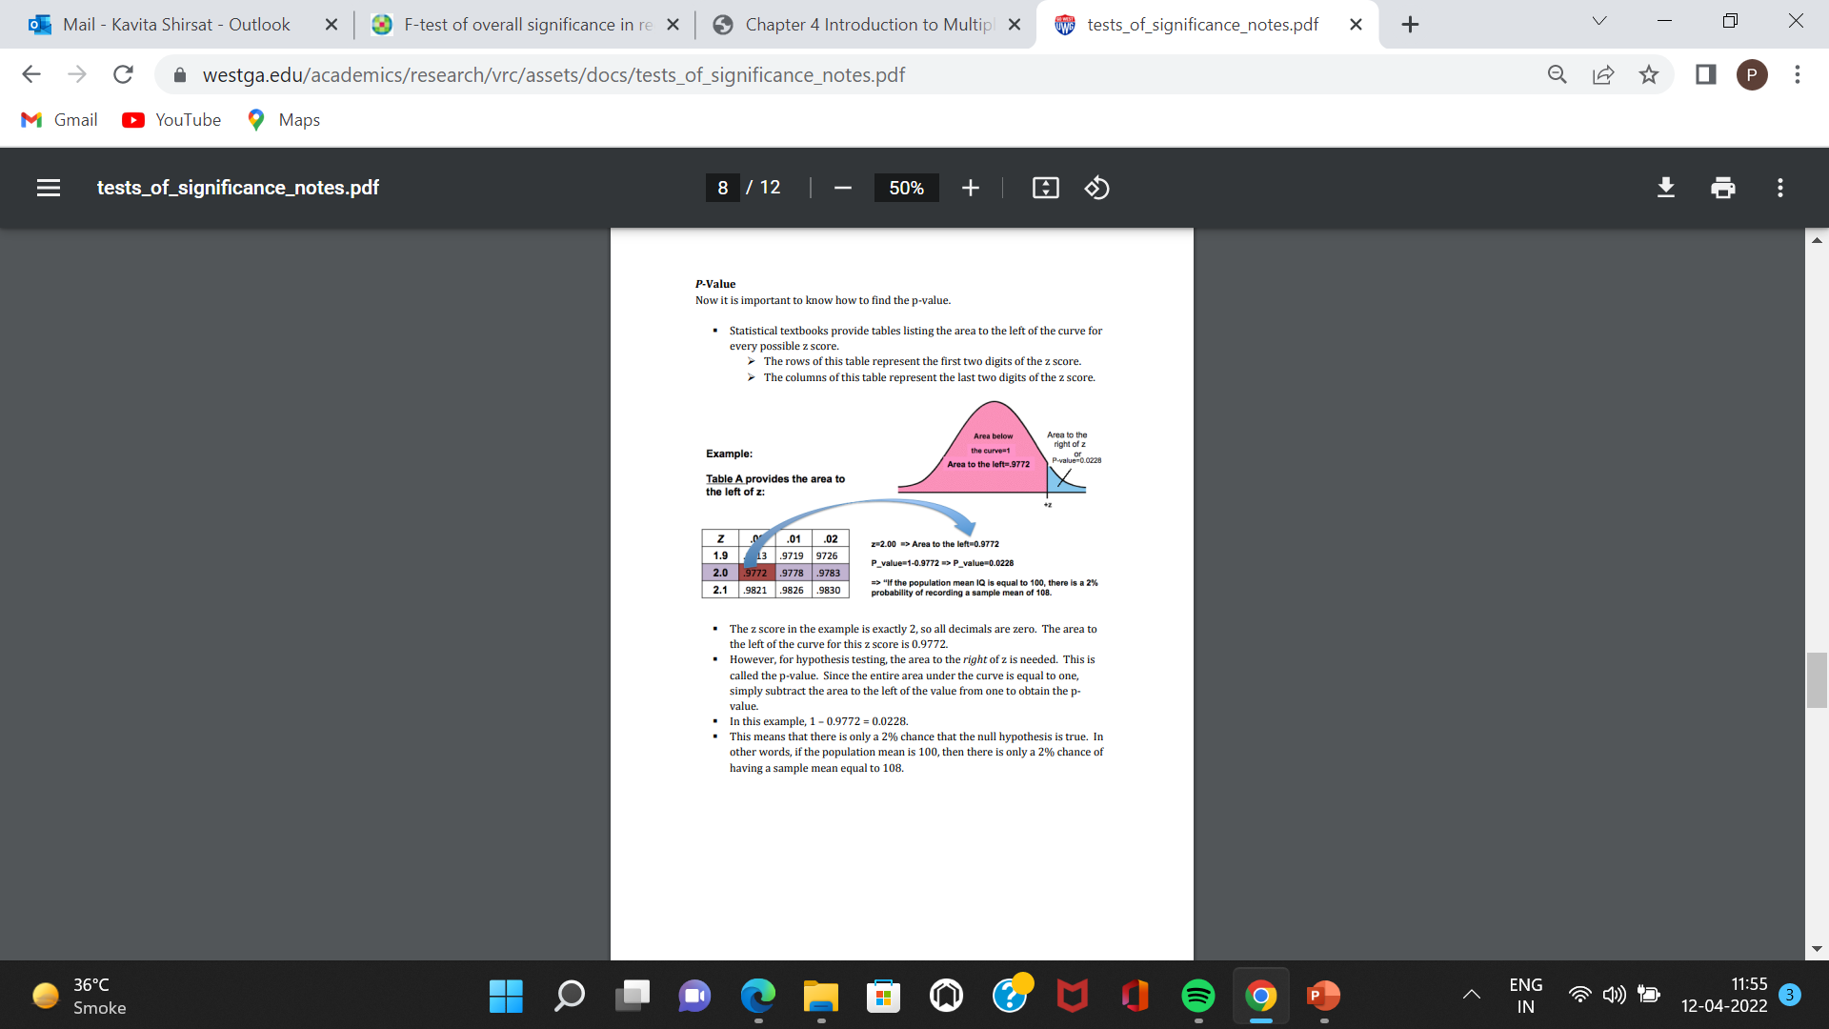
P-Value
P-Value Now it is important to know how to find the p-value.
Statistical textbooks provide tables listing the area to the left of the curve for every possible z score.
The rows of this table represent the first two digits of the z score.
The columns of this table represent the last two digits of the z score.
The z score in the example is exactly 2, so all decimals are zero. The area to the left of the curve for this z score is 0.9772.
However, for hypothesis testing, the area to the right of z is needed. This is called the p-value. Since the entire area under the curve is equal to one, simply subtract the area to the left of the value from one to obtain the pvalue.
In this example, 1 – 0.9772 = 0.0228.
This means that there is only a 2% chance that the null hypothesis is true. In other words, if the population mean is 100, then there is only a 2% chance of having a sample mean equal to 108

Slide 35
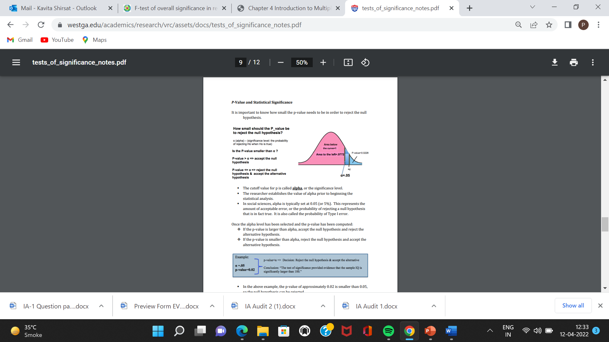
P-Value and Statistical Significance
It is important to know how small the p-value needs to be in order to reject the null hypothesis.
The cutoff value for p is called alpha, or the significance level.
alpha is typically set at 0.05 (or 5%). This represents the amount of acceptable error, or the probability of rejecting a null hypothesis that is in fact true. It is also called the probability of Type I error. Once the alpha level has been selected and the p-value has been computed:
If the p-value is larger than alpha, accept the null hypothesis and reject the alternative hypothesis.
If the p-value is smaller than alpha, reject the null hypothesis and accept the alternative hypothesis.
In the above example, the p-value of approximately 0.02 is smaller than 0.05, so the null hypothesis can be rejected.
The test of significance showed that the difference between the sample mean and the population mean is statistically significant.

Slide 36
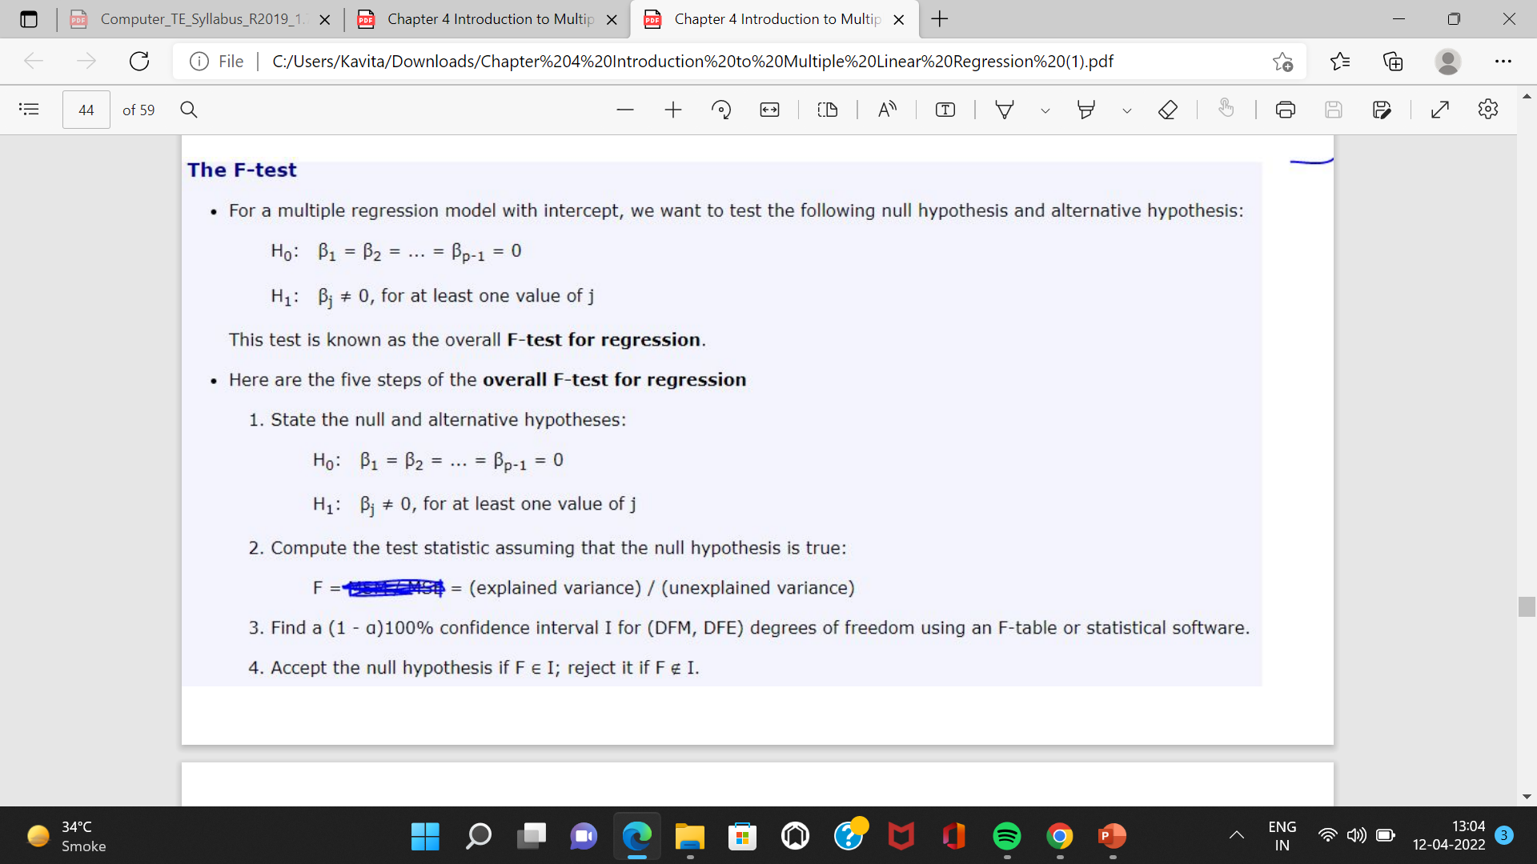


Slide 37
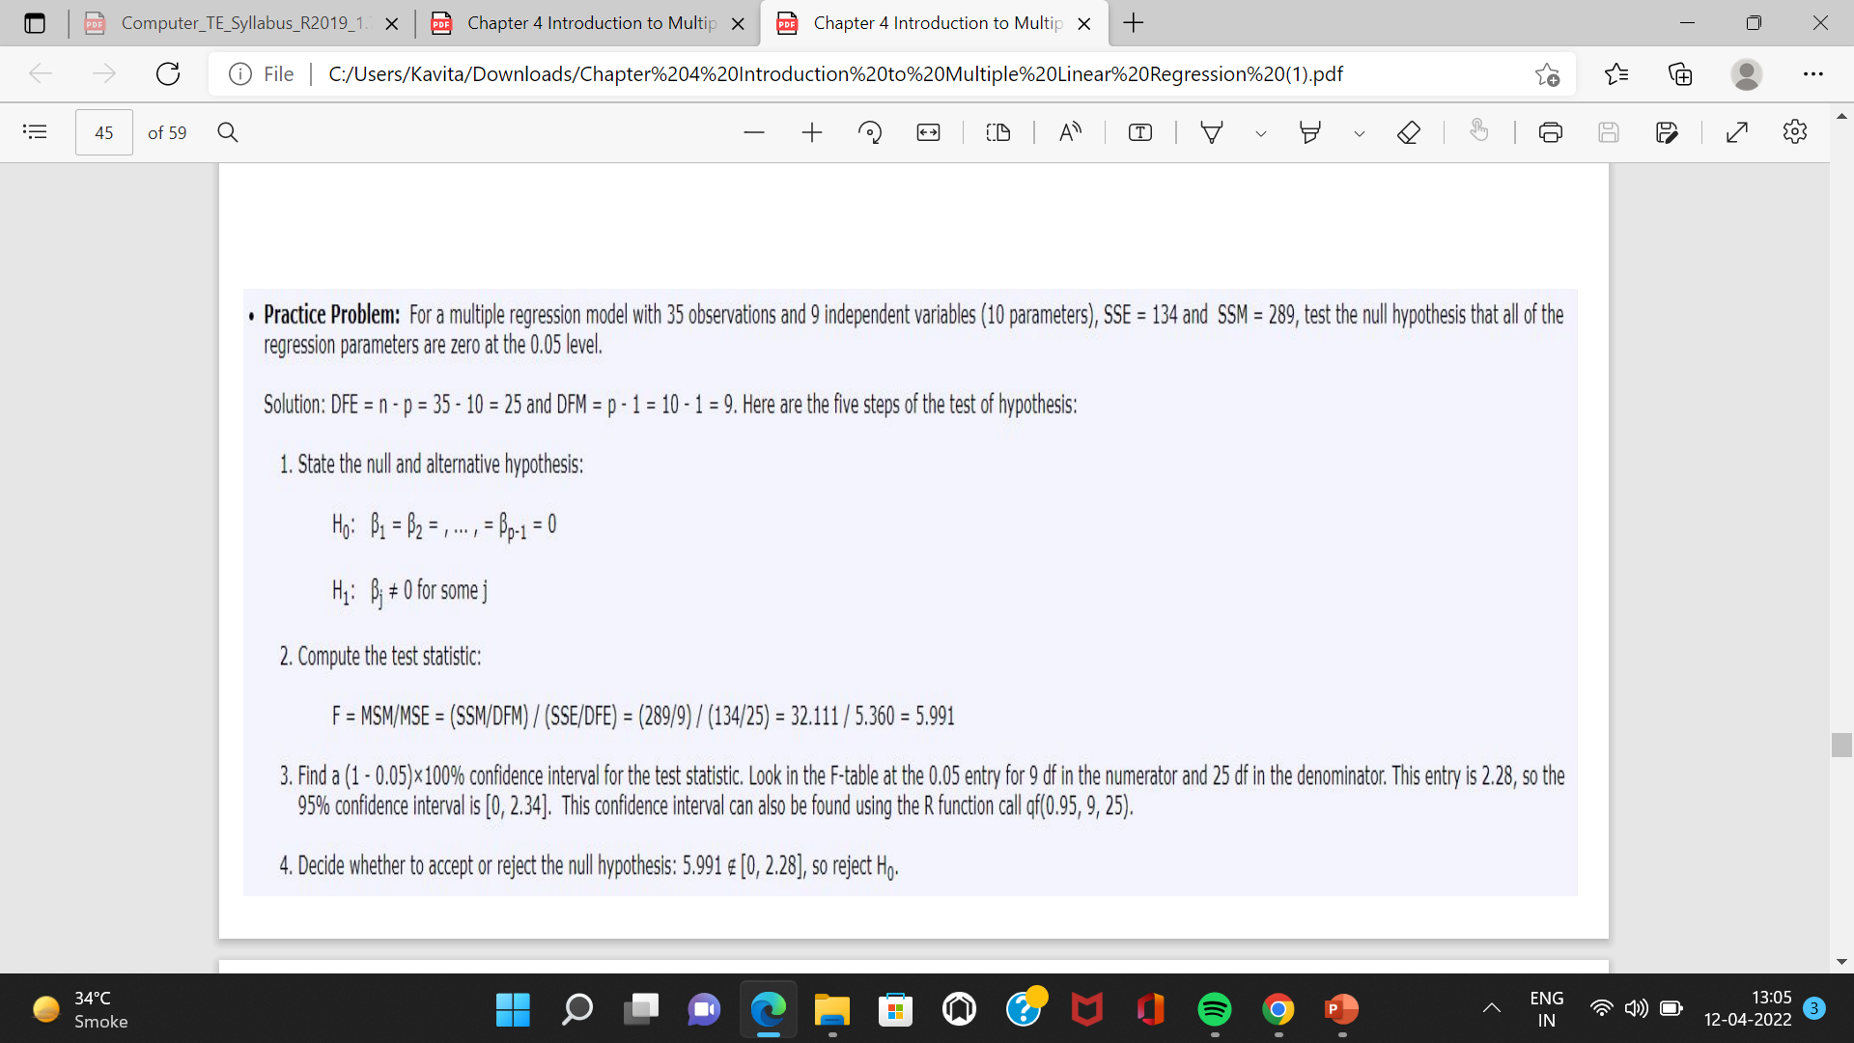

Slide 38
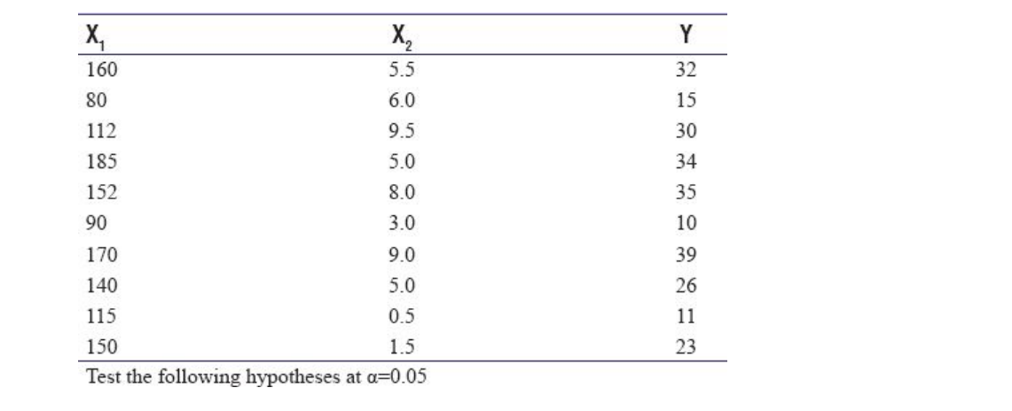

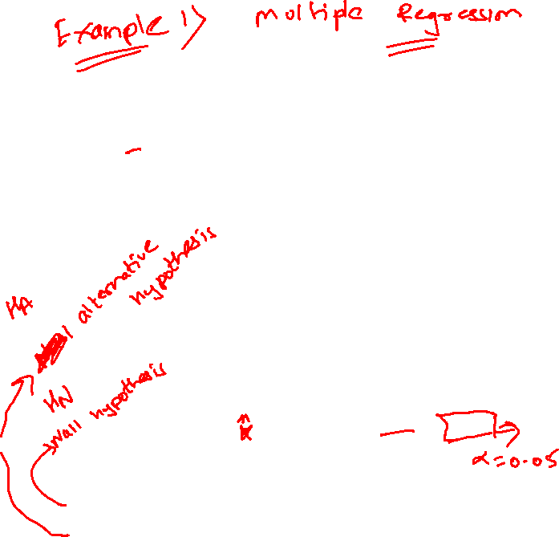
In estimating output (Y) of physiotherapist from a knowledge of his/her test score on the aptitude test (X1 ) and years of experience (X2 ) in a hospital, the summarizes the findings of the study
Obtaining the regression equation
H₀: Y = b₀ H₁: Y = b₀ + b₁X₁ + b₂X₂

Slide 39
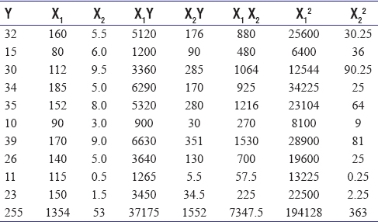
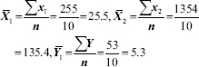
Obtaining the regression equation
H₀: Y = b₀ H₁: Y = b₀ + b₁X₁ + b₂X₂

Slide 40
The general form of multiple equation applicable in this case is: Y = b₀ + b₁X₁ + b₂X₂ Moreover, the required normal equations to find the values of b₀, b₁, and b₂ can be written as under:
Accordingly, the three equations are: 255 = 10 b₀+ 1354 b₁+ 53 b₂ 37175 = 1354 b₀+ 194128 b₁+ 7374.5 b₂ 1552 = 53 b₀+ 7347.5 b₁+ 363 b₂ Solving the three equations simultaneously, we obtain b₀ = −13.824567, b₁= 0.212167, and b₂= 1.999461. Thus, the regression equation of Y on X₁ and X₂ is:
Y_{C}= -13.824567 + 0.212167 X₂+ 1.999461 X_{2.}

Slide 41
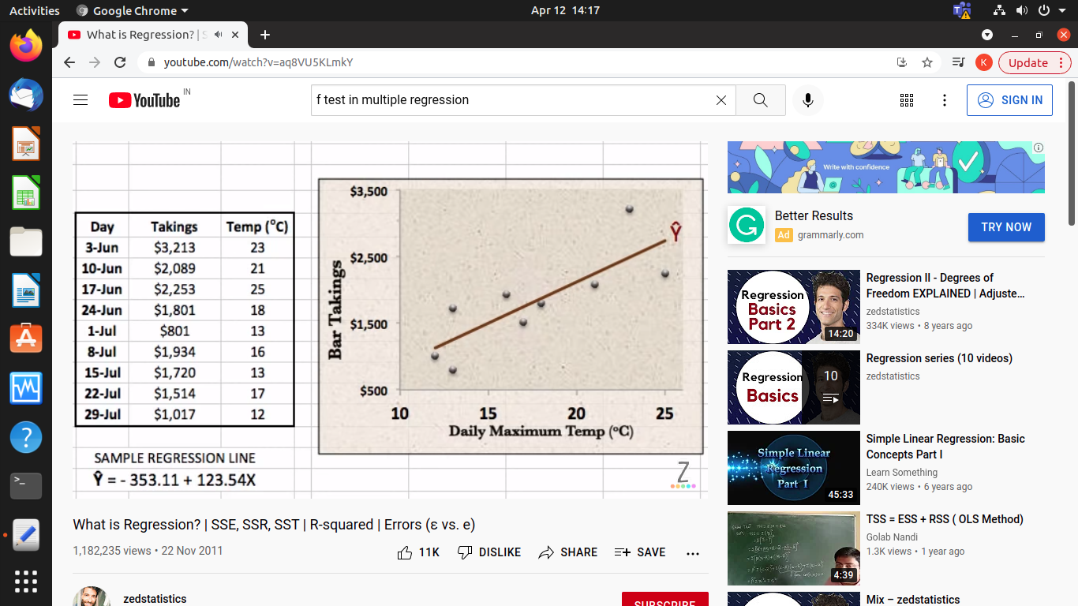

Slide 42
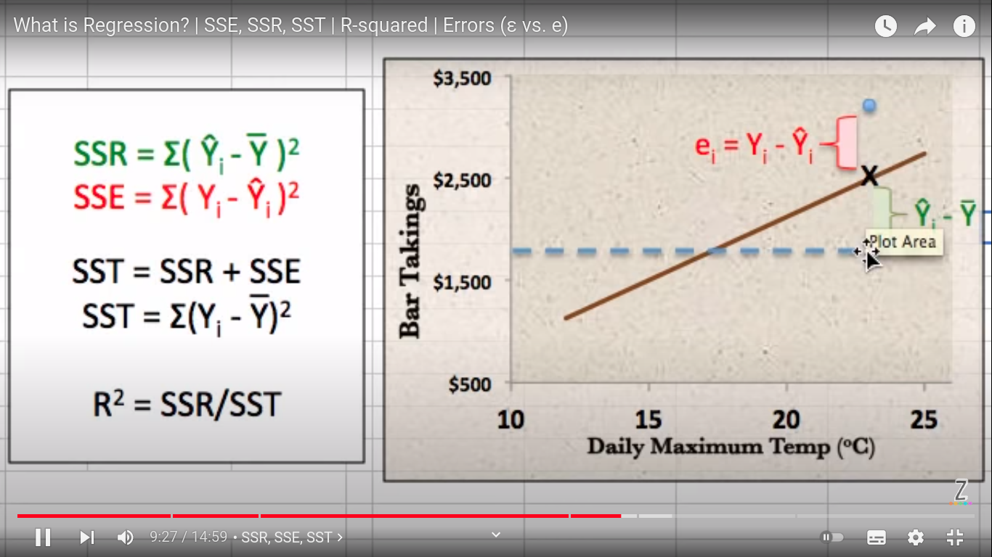

Slide 43
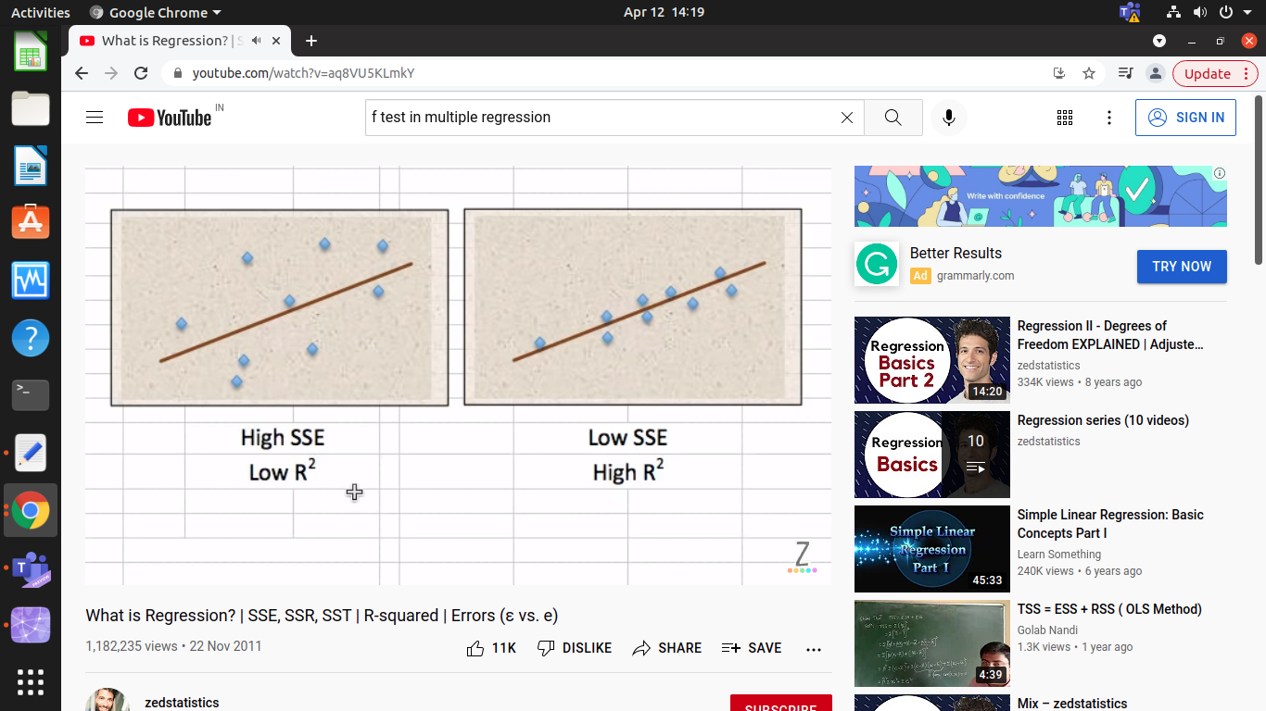

Slide 44
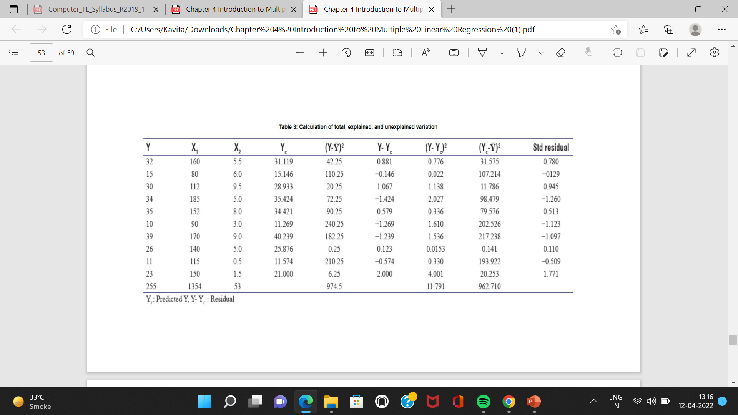
Calculation of R and F-ratios

Slide 45
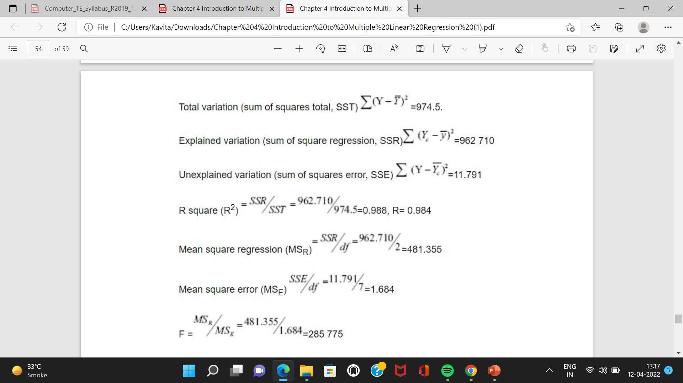
Calculation of R and F-ratios
Goodness of fit The F table value [Table 4] corresponding with degree of freedom n₁= 2 and n₂= 7 is 4.74. Since 285.775>4.74, we ignore the null hypothesis and conclude that Y = b₀ or Y = b₀+ b₁X₁+ b₂X₂.

Slide 46
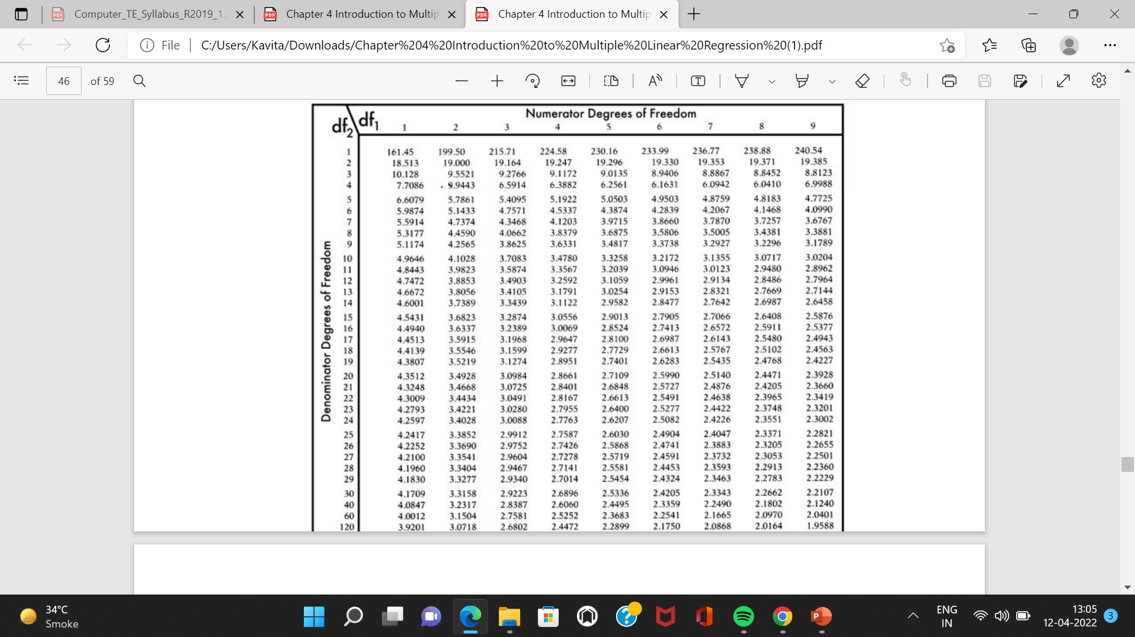

Slide 47
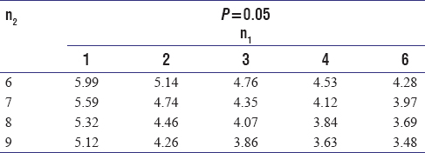
Calculation of R and F-ratios
Goodness of fit The F table value [Table 4] corresponding with degree of freedom n₁= 2 and n₂= 7 is 4.74. Since 285.775>4.74, we ignore the null hypothesis and conclude that Y = b₀ or Y = b₀+ b₁X₁+ b₂X₂.

Slide 48
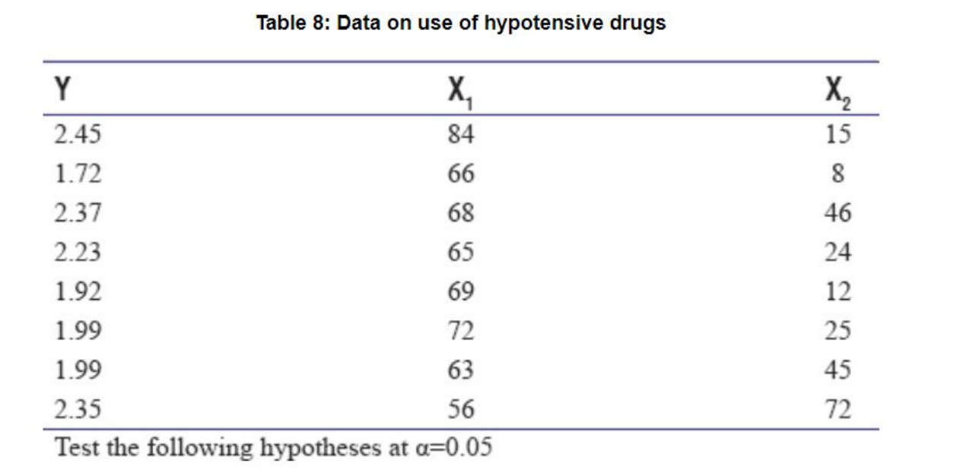
The data in [Table ] are taken from a clinical trial to compare two hypotensive drugs used to lower the blood pressure during operations. The dependent variable, y, is the recovery time (in minutes) elapsing between the time at which the drug was discontinued and the time at which the systolic blood pressure had returned to 100 mmHg. The two predictors are quantity of drugs used in mg (x1 ) and mean level of systolic blood pressure during hypotension in mmHg (x2 )

